Slide 1




Measuring Gameplay Affordances of User-Generated Content in an Educational Game
Michael Eagle
Carnegie-Mellon University
Andrew Hicks, Zhongxiu “Aurora” Liu, Tiffany Barnes
North Carolina State University
Notes:
Hello everyone, my name is aurora. A 2nd year phd student researching educational games. Here i present my work with Drew, Dr. Tiffany Barnes and Mike : “Measuring gameplay affordances of user-generated content in an educational game

Slide 2
Measuring Gameplay Affordances of User-Generated Content in an Educational Game
1/34
Notes:
First, let me introduce “an educational game”

Slide 3
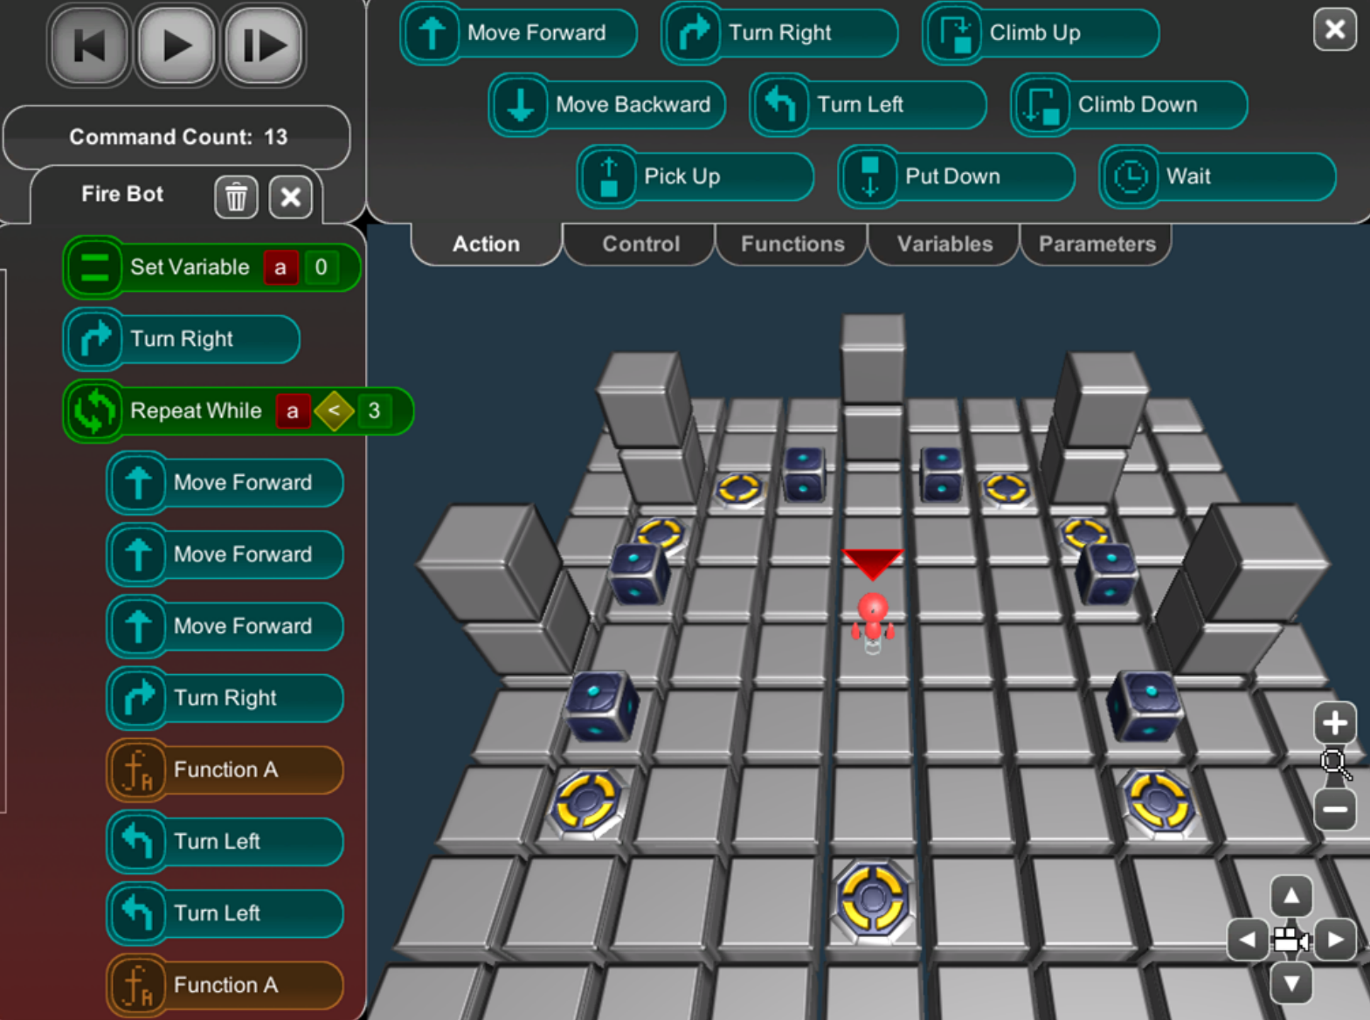
BOTS
IV. Repetitive patterns in puzzle encourages the use of loops/functions to reduce command count
III.The less commands a student use, the better medal s/he gets
I. Students write program through drag and drop actions, functions, loops, etc
II.The goal is to command the robot to either stand on or put a box on every yellow crate
2/34
Notes:
BOTS is a programming game designed to teach fundamental concept of coding to novice, through levels of puzzles. Students write program through drag and drop commands, functions, or loops. The goal is to command the robot character to either stand on or put a box on every yellow crate. The less command…., as we can see from the ‘command count’. Rpetitive……. As we can see from this specific puzzle, students need to recognize the repetitive patterns of how boxes and crates are locate, and write loops and functions to solve it.

Slide 4
Measuring Gameplay Affordances of User-Generated Content in an Educational Game
3/34
Notes:
Next, i’m going to introduce another keyword from the title, gameplay affordance

Slide 5
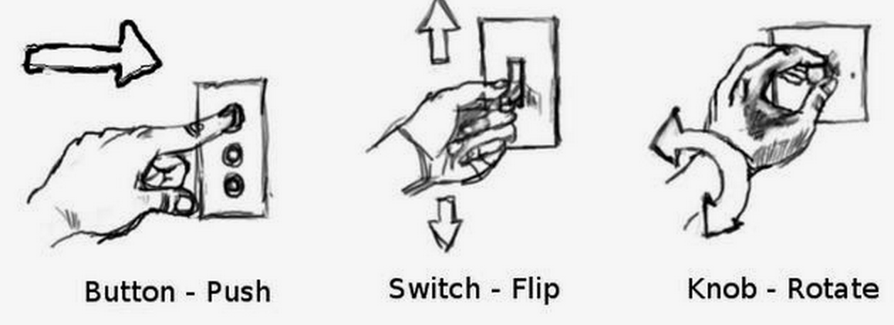
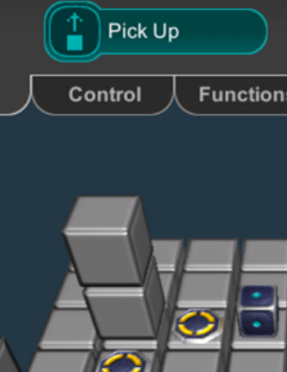
Affordance (Norman, 1988)
Gameplay Affordance (Gee, 2009)
Affordance for desired gameplay patterns
Produced by structures between world & player, tool & player
Rewarded through gameplay outcomes
4/34
Notes:
First, affordance is an HCI term, defined as “the perceived or actual properties of the thing, primarily those fundamental properties that determine just how the thing could possibly be used”. Basically, the degree that the property of a thing tells about how to use it. For example, you see button and you know you push. You see switch……
Gameplay affordance, is desired gameplay produced by structure between world & players. For example, in bots, we see a box, and we know this is suppose to be picked up.

Slide 6
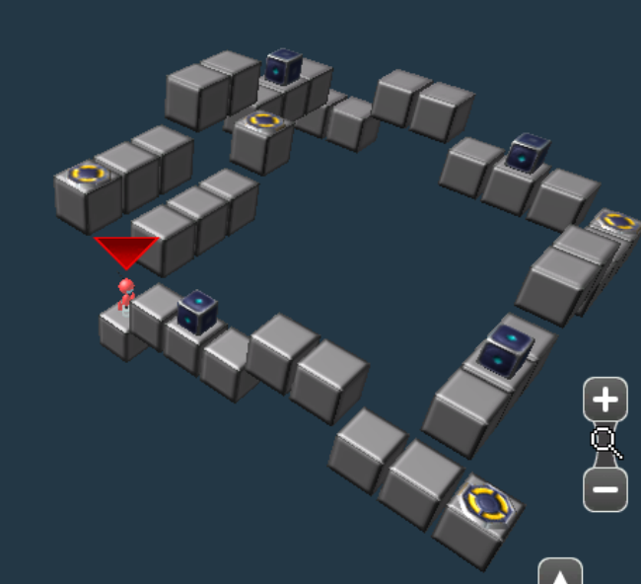
Gameplay Affordance (Gee, 2009)
Educational Gameplay Affordance
Subsets of affordance which reward specific, desired patterns of gameplay related to the game’s learning objectives.
5/34
Notes:
Next we moves to educational gameplay affordance. Basically, the affordance should not only help players play, but also assist in achieving educational goals. In the context of bots, subsets of …………. And through which, players…….. For example, in the puzzle below, you see clear repetitive pattern that encourage students to solve the puzzle through optimization, with loops and functions

Slide 7
Measuring Gameplay Affordances of User-Generated Content in an Educational Game
6/34
Notes:
Last key word to address in title, is user-generate content. It is very important and let me tell you the eason

Slide 8
Why? – the Cost
Content is costly (as we all know) and even more so for educational games
Need Subject-Matter Expert
Need Game Design Expert
Expect a 300 : 1 ratio in design hours, and tutor hours.(Murry, T. 1999. Authoring Intelligent Tutoring Systems: An Analysis of the State of Art. IJAIED, 10, 98-129)
7/34
Notes:
Second reason for user-content is the pedagogically benefit of problem-posing. Problem posing is the concept that learning is formulated through the conversation between both student and teachers….<ask drew>

Slide 9
Why? - Pedagogical Benefits
Creating exercises has been used in the form of Problem-posing across domains.
A beneficial activity in both traditional classrooms(Bourgonjon et al., 2010; Silver, 2013) and educational games (Hirashima&Kurayama, 2011; Birch&Beal, 2008;)
Students feel engaged, proud and low self-assessment students feel easier (Birch&Beal, 2008; Arroyo&Woolf, 2003; Chang et al, 2012)
8/34
Notes:
Second reason for user-content is the pedagogically benefit of problem-posing. Problem posing is the concept that learning is formulated through the conversation between both student and teachers….<ask drew>

Slide 10
Why? – to Broaden Engagement
Designing a problem is a self-directed behavior, with self-selected goals
This type of play will engage players of different types, where many traditional games fail short (Greenberg et al., 2010; Bourgonjon et al., 2010)
Engaging different user types is important in educational game
9/34
Notes:
Same, ask drew. Be mroe sepecific

Slide 11
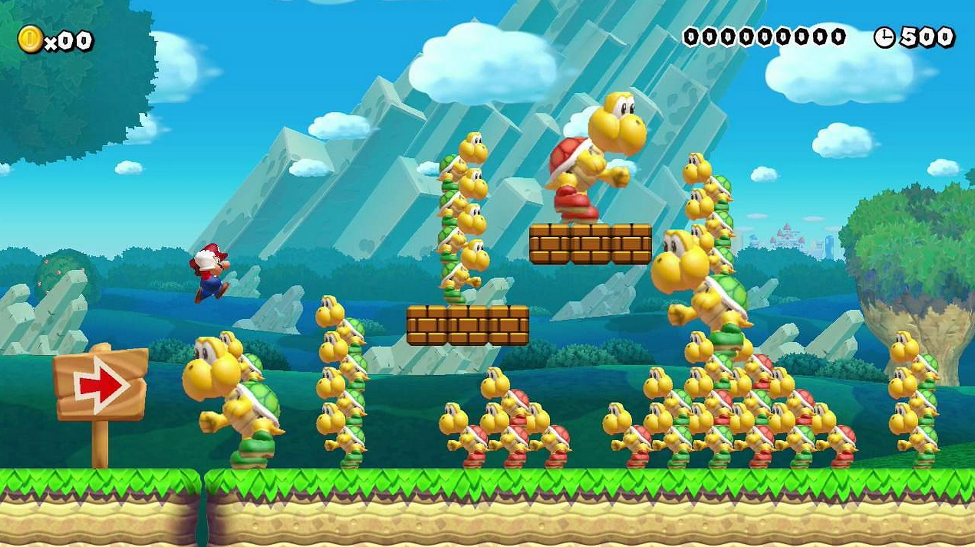
Why NOT?
User-generated content is often poor quality.
Users often generate content far below their own skill level.
(Nintendo, 2008)
10/34
Notes:
Now we’ve hear about the good things, why not every educational game use user generated content. Obviously, user generated contente…… users often…. An example, out of the context of bots, is mario game maker. Some audience probably play it before. Its a game where you can create obstacles for super mario, publish your worlds, and let other players online play it. Sometimes you play levels that you spend so many effort going through obstacles, and found actually the little door at the beginning direclty lead to destination. Or, as this graph show, some game is not win by skill, but win by pure luck.
Now as you probably guess, this problem is worse in the context of educational game. You want the game for students to learn, and if students create content purely for fun without gameplay affordance, you didn’t achieve your educational goal.

Slide 12
Solutions?
Human moderation?
Very costly, especially at scale
Delay between submission and acceptance
Solve-and-Submit?
Students can still create (but not publish) low-quality levels
Students can still publish bad (no educational benefit) levels
Only fixes half of the problem
11/34
Notes:
There are some solutions. One is human moderation, aparently , its costly, especially at scale, and cause delay between submission and acceptance of content.
Another solution, also implemented in Mario game maker, is solve-and-submit. User need to pass the level s/he designed before submitting it. It is eff…, but stud….. This solution, only fixes half of the problem

Slide 13
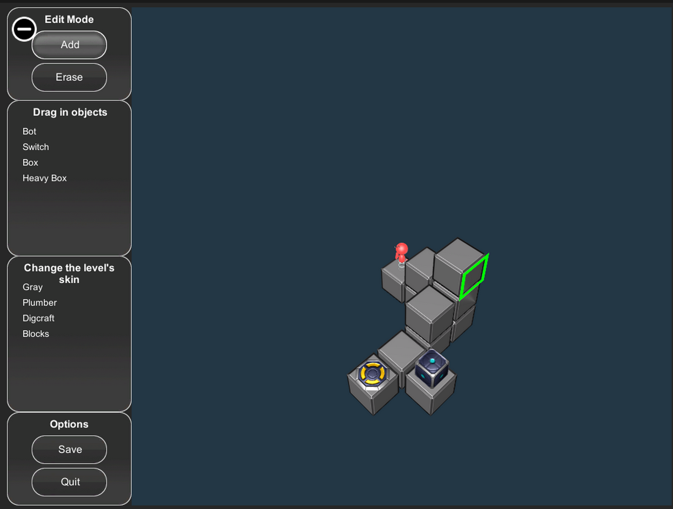
Existing (Free-Form) Editor
Resembles Minecraft: Students can click anywhere to create blocks, and Drag and drop any Objects. Just need to have a start point and end goal.
12/34
Notes:
Previous, bots use solve&submit. The original editor, we refer to as free-form is shown below…….iT just like minecraft where select object, put them wherever in the world, and specify start point and goal.

Slide 14
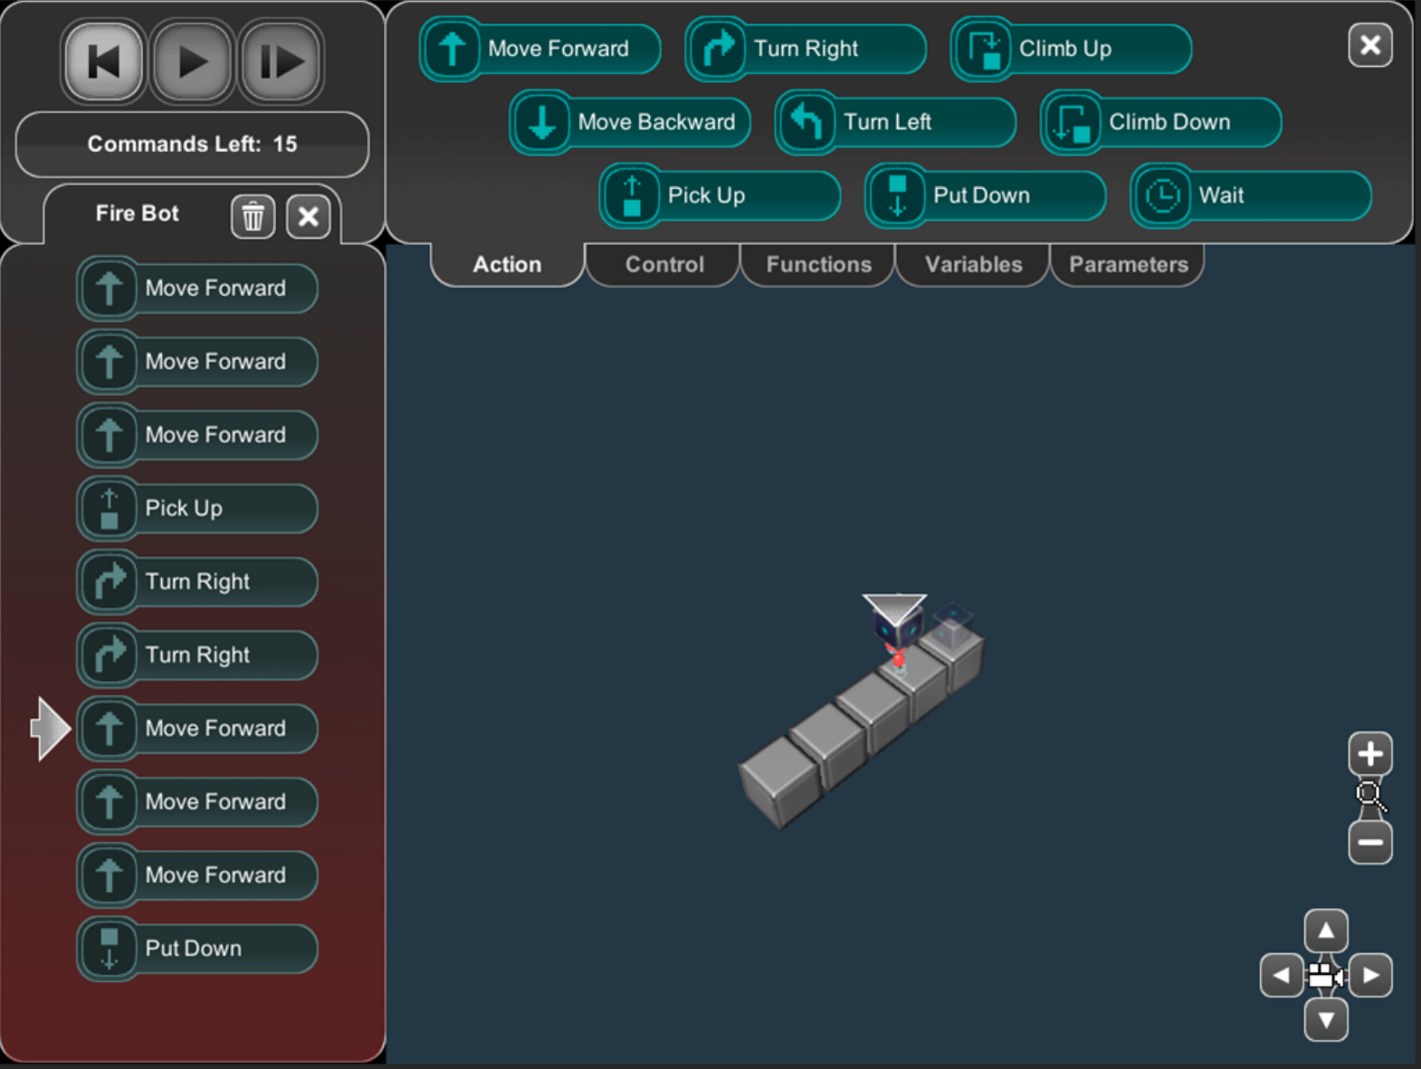
Programming Editor
II.Number of commands is limited to constrain “canvas-filling”
I. Puzzles are created through programming the path the robot will take
13/34
Notes:
The first one is programming editor, puzzles are created through programming the path the robot will take. For example, if you program 5 move forwards, the puzzle will occur as a line of five blocks.
The design is inspired by deep gamification, where players are encouraged to perform more complex operations in order to generate larger and more interesting levels
One challenge is that all programs are correct. So student may still create puzzles with trivial solutions, or puzzle with no goal in mind.

Slide 15
Programming Editor
Advantage: Deep Gamification (Boyce, 2014). Players are encouraged to perform more complex operations to generate larger and more interesting puzzles.
Challenge: All programs are correct. Students may still create puzzles with trivial solutions, or puzzles with no goal in mind (not even understandable by themselves).
14/34
Notes:
The first one is programming editor, puzzles are created through programming the path the robot will take. For example, if you program 5 move forwards, the puzzle will occur as a line of five blocks.
The design is inspired by deep gamification, where players are encouraged to perform more complex operations in order to generate larger and more interesting levels
One challenge is that all programs are correct. So student may still create puzzles with trivial solutions, or puzzle with no goal in mind.

Slide 16
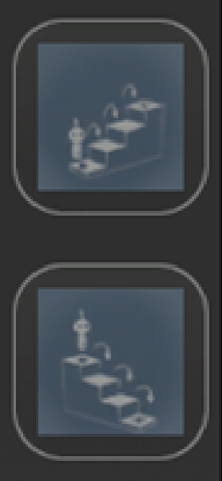
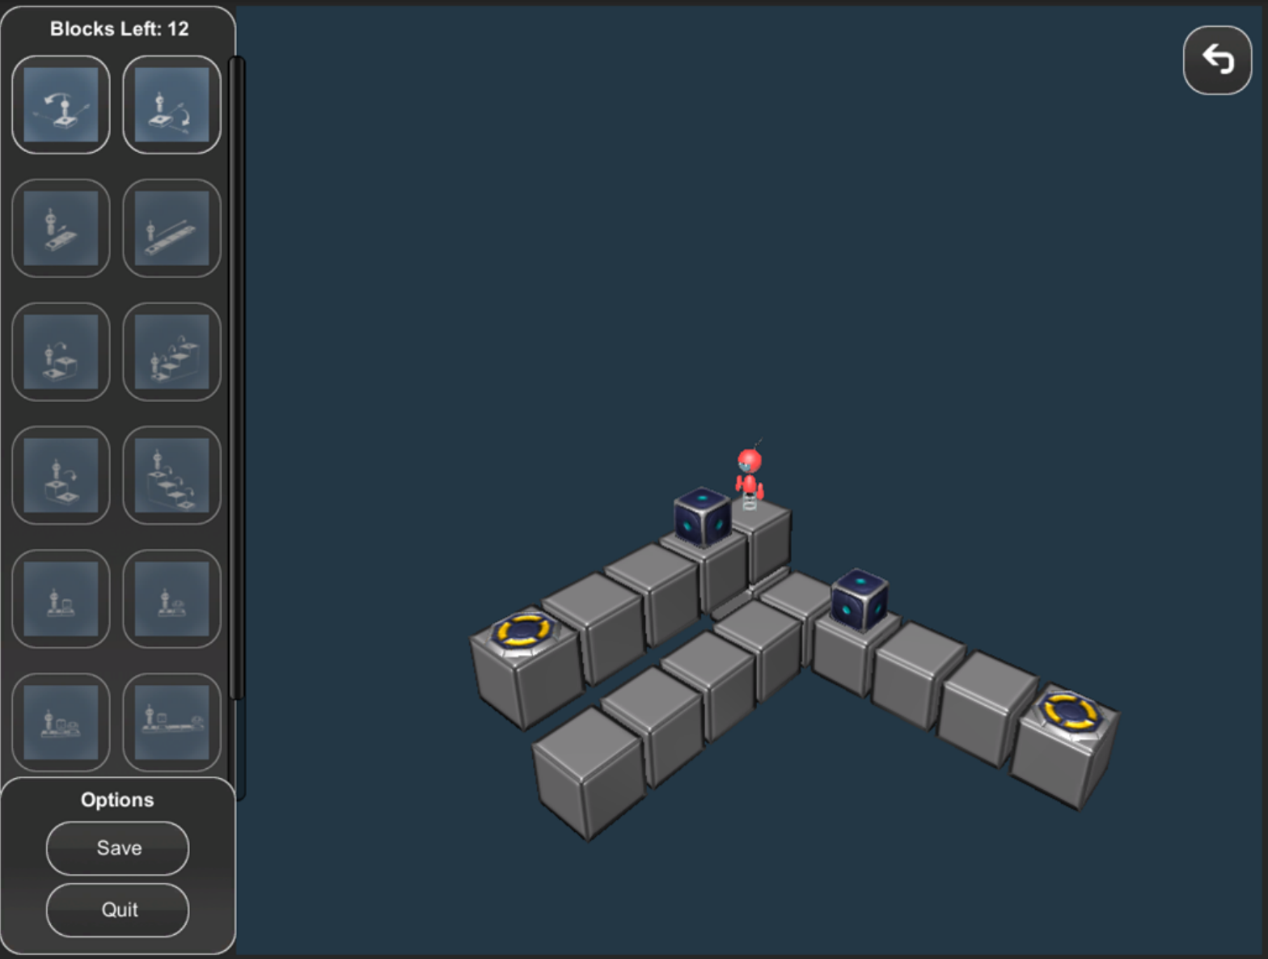
Building-Block Editor
I.Students use gameplay affordance “blocks” as the unit of designing puzzles
II. Number of blocks is constrained
15/34
Notes:
Next is bbe. This editor use pre…… for example, user can create stairs of four by using the blocks on the left. We hypothesize that Simplifying the construction of patterns may result in puzzles with more repetitive pattern, and thus increase the gameplay affordance of using loopfunctions

Slide 17
Building-Block Editor
Advantage: “problem posing”. meaningful expert-designed pattern as subparts of problems, which encourages more complex programming constructs: loops, functions, variables.
Challenge: Restrict choice of patterns may reduce creativity.
16/34
Notes:
Next is bbe. This editor use pre…… for example, user can create stairs of four by using the blocks on the left. We hypothesize that Simplifying the construction of patterns may result in puzzles with more repetitive pattern, and thus increase the gameplay affordance of using loopfunctions

Slide 18
Measuring Gameplay Affordances of User-Generated Content in an Educational Game
17/34
Notes:
Now on understanding the advantage, challenge of user-generated content and our suggested approach, lets proceed to the ‘measuring’ part. From where i will introduce or method and result.

Slide 19
This Study - Experimental Design
Data: across STEM outreach programs, with choice of editors varied per collections
Experiment: 45 minutes BOTS tutorial (solve levels of pre-designed puzzles, with instructions on variable, loop,function) -> create puzzles
Editor Type | Free-form | Programming | Block | Total
#Students | 72 | 61 | 48 | 181
#Puzzles Published | 92 | 49 | 33 | 175
18/34

Slide 20
This Study - Measurement
Differences between naive and expert solutions (optimized by algorithm from student’s solution)
HIGH differences=> Larger space for more optimization through loops and functions (Gameplay Affordance)
Thus, we want LOW occurrence of levels with NO gameplay affordance
Puzzles with 0 gameplay affordance were found in prior work (Hicks et al., 2014)
19/34
Notes:
Next, how do we measure success. We consider a good puzzle to be hihg…….. This give larger……. This is the gameplay affordance in the context of this problem.
Thus, we want low …….
Puzzles with 0 gameplay affordance are found frequently in prior work. I’ll show you in the enxt slide

Slide 21
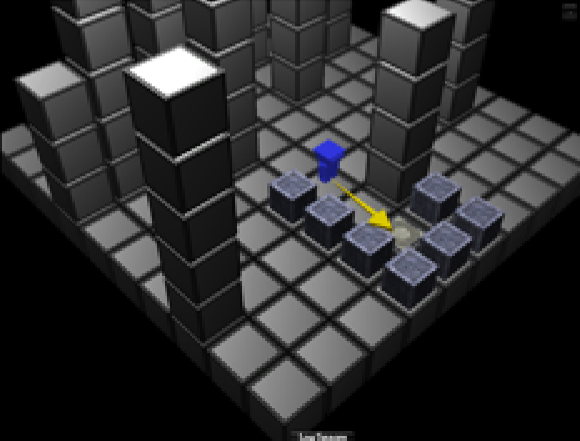
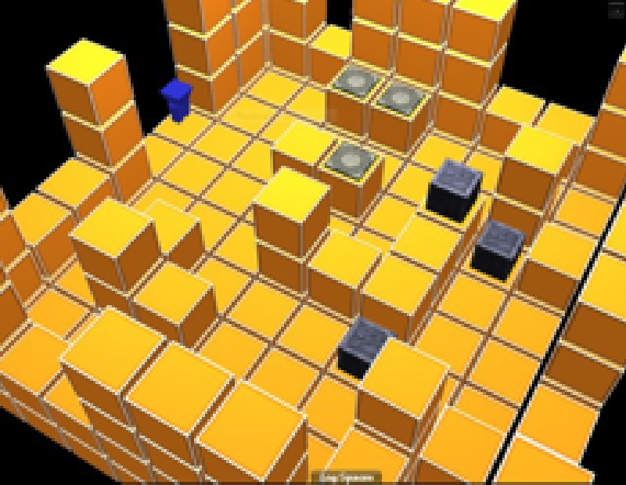
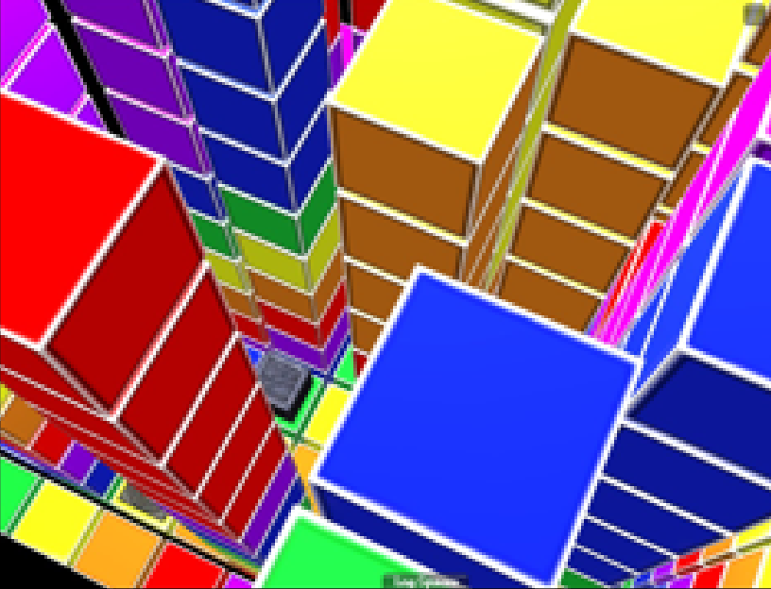
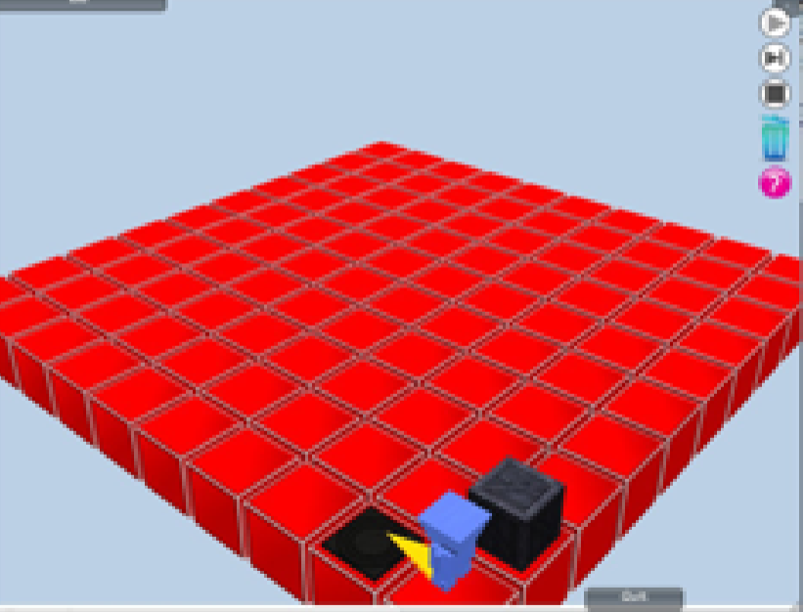
Examples of 0 Gameplay Affordance Puzzles
Sandbox
Distracting structure
Trivial/non-existent solutions
“I created a pretty puzzle. Don’t care about solving”
Griefer
Obscure/non-existent solutions
Distracting structures, objects, or spelled words that serve no use
“I created skycrapers so you can’t find any box!! ”
Power-gamer
Tedious/obscure/non-existent solutions with few repeated patterns
“I want to make you SURRENDER&FAIL”
Trivial
Trivial solution in 1 or 2 moves
“I used the shortest time i can to create a puzzle and I’m done”
20/34
Notes:
Here are examples of 0 gameplay affordance. The first one is calleed…… is describes…… think about user have this in mind when creating it “.......”
Same for all four puzzles

Slide 22
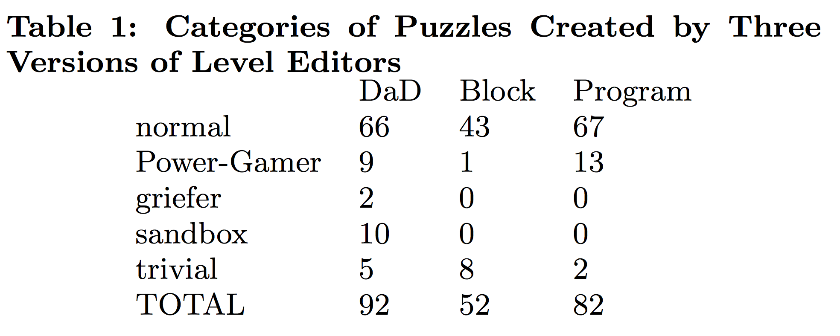
Result I – Expert Tagging
Block&Programming editors eliminate Griefer and Sandbox levels (as we had previously defined them)
Trivial levels are reduced in Programming editor but increased in Block editor. These levels MAY contain gameplay affordances, but they will be low-value.
Power-gamer increased in Programming editor
FF
21/34

Slide 23
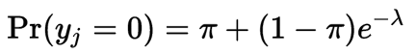
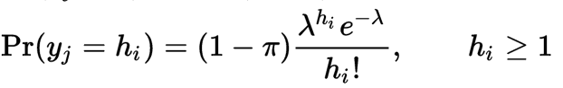
Zero-Inflation Model
We used a Zero-Inflation model due to excess zeroes exist, Two processes are involved in zero-inflation model:
Process I: generates excess zeroes through binomial distribution
Process II: generates regular results (may also contains normal number of 0s) with Poisson distribution
22/34
Notes:
Now we understand the frequent occurrence of 0s, let me introduce the model we use to fit this challenge. We used a ….this model consists of two processes: first ….. second….

Slide 24
Zero-Inflation Model
Useful when:
Your data has a lot of zeroes
There is a theoretical reason for why excess 0s are created
23/34

Slide 25
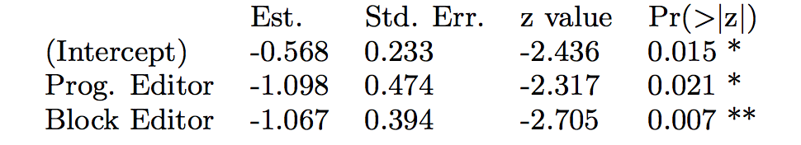
Result II
Process I: Zero-inflation Model (Binomial Distribution)
Both new editors improve over the free-form editor when the ‘excess zeroes’ are considered. This correlates with the reduction in Trivial levels, which were similarly defined.
24/34

Slide 26
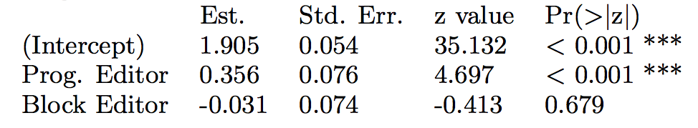
Result II
Process II: Count Model (Poisson Distribution)
The Programming editor produces significantly higher scores overall, indicating levels with more gameplay affordances.
Students are observed to explore with loops/functions more
Did not find evidence for Block Editor:
Blocks themselves are short, won’t result in large differences unless using blocks repetitively.
25/34
Notes:
This model also suggests that the programming editor is likely to produce a higher score
This has multiple interpretations:
students create larger levels with similar optimizations
Students create levels with more effective optimizations

Slide 27
Result II
Zero-inflated model is great to see both what causes excess 0, and what causes change in scores
Next: does student performance in tutorial (prior skill) matter?
26/34

Slide 28
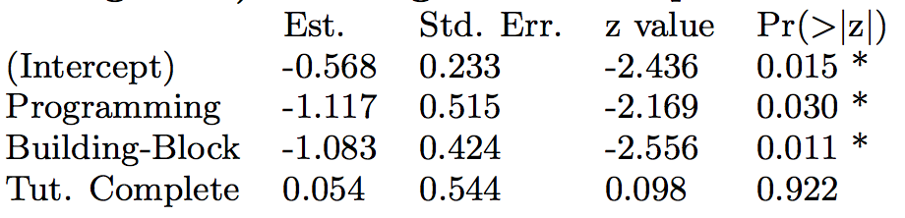
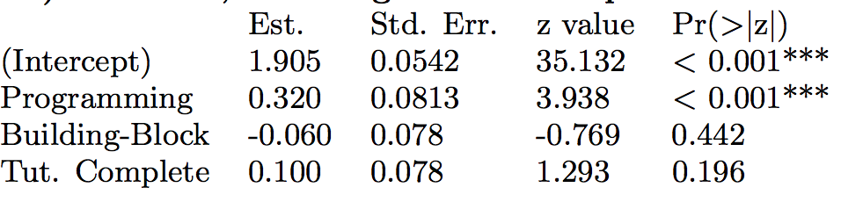
Result III
Process I: Zero-inflation Model (Binomial Distribution)
Process II: Count Model (Poisson Distribution)
27/34

Slide 29
Discussion III
Adding the “Tutorial Completion” variable to the models does not strongly influence our interpretations.
=> regardless of prior skill, users of Programming and Blocked-based editor are less likely to create zero game affordance levels (and lower-valued levels).
28/34

Slide 30
Measuring Gameplay Affordances of User-Generated Content in an Educational Game
29/34
Notes:
First, let see the whole big picture. What we learned from this study, and what it means to the board EDM community.

Slide 31
Conclusions
This study contributed:
- a user-study and methods to improve user-generated content.
- a theory that causes undesired content.
a use-case for zero-inflation model.
a novel measurement – gameplay affordances to testify user-generated content against pedagogical goals
30/34

Slide 32
Conclusions
Provide meaningful tools that resemble player’s problem solving process
Use Innovative Measurements that tie game mechanism to educational goal
Shallow Gamification
Deep Gamification
Learning is a step toward gameplay or reward
Learning IS play, Learning is tied to the core game mechanism
Gameplay creates opportunities and communities for learning
31/34

Slide 33
Future Work
High gameplay affordance can be:
Students create larger levels with similar optimizations
Students create levels with more effective optimizations
Further analysis is needed to determine which interpretation is most true, and if future players will take advantage of the increased gameplay affordances, or ignore them
32/34

Slide 34
Acknowledgments
Thanks to Michael Kingdon, Aaron Quidley, Veronica Catete, Rui Zhi, Yihuan Dong, and all developers who have worked on this project or helped with our outreach activities so far. This project is partially funded under NSF Grant Nos. 0900860 and 1252376.
33/34

Slide 35
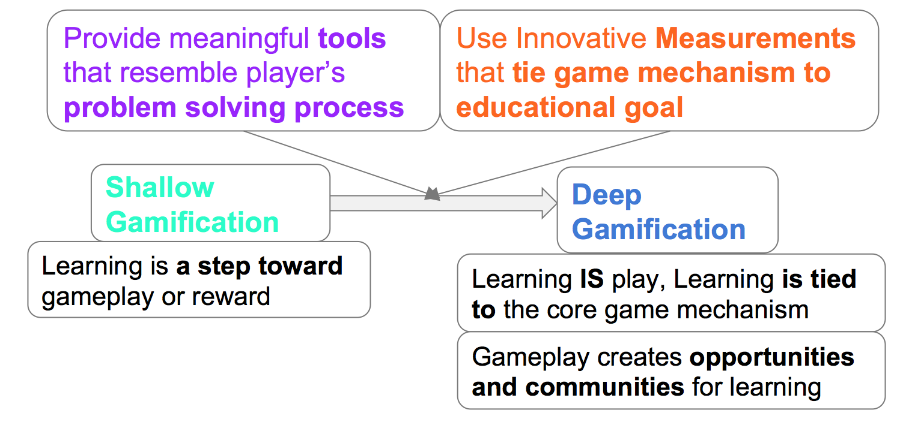
Thank You!
Try out BOTS @ http://bots.game2learn.com/
34/34

